Slide 1
TALHFA HFC Boot Camp
Private Activity Bonds (PAB) Presentation
October 2023

Slide 2
What is a PAB?
Title 26 Internal Revenue Code, TGC Ch. 1372
Promotes certain private activities (which benefit the public), each state is authorized to issue a set amount of Private Activity Bonds each year which may be used for multifamily housing, single-family housing, student loans and industrial development.
This set amount is called “Volume Cap.”
PAB is a bond issued by or on behalf of a local or state governments for the purpose of financing the project of a private user.
Moves the project risk the private sector.
Private debt sold like a public security (tax-exempt).

Slide 3
State and Federal Statutes
State Statute/ Codes
Chapter 1372 - Private Activity Bonds and Certain Other Bonds
Texas Administrative Code §190.1 - §190.8
§190.1 - General Provisions
§190.2 - Allocation and Reservation System
§190.3 - Filing Requirements for Applications for Reservation
§190.4 - Filing Requirements for Applications for Carryforward
§190.5 - Consideration of Qualified Applications by the Board
§190.6 - Expiration Provisions
§190.7 - Cancellation, Withdrawal and Penalty Provisions
§190.8 - Notices, Filings, and Submissions
Federal Statutes
Internal Revenue Code of 1986
141 - Private activity bond; qualified bond
142 – Exempt Facilities
143 - Mortgage revenue bonds: qualified mortgage bond & veterans’ mortgage bond
145 - Qualified 501(c)(3) bond
146 - Volume cap
148 - Arbitrage
149 - Bonds Must be Registered to be Tax Exempt
.

Slide 4
Texas PAB Borrowers
Low-income housing developers (through TDHCA, TSAHC, HFCs and PFCs)
Small industry (IDCs, or EDCs)
Large industry mitigating waste (IDCs, or EDCs)
THECB and other state issuers
Higher Education Authorities
The private portion of P3s in some transportation projects
TDHCA, TSAHC, Local HFCs for mortgage revenue bonds (MRBs) or mortgage credit certificates (MCCs)

Slide 5
Benefits of PABs
A lower interest rate paid on borrowed money, providing cost savings for project expenditures.
Reduced project risk. The risk is shifted to the private sector.
The opportunity to complete projects with a positive benefit for the community.
Secure tax-exempt financing to fund capital expenditures.
Housing transactions are allowed access to 4% tax credits

Slide 6
Private Activity Bond Volume Cap
The State of Texas received $3,603,548,640 in PAB allocation in 2023:
IDBs 2% - $72,070,973
State Voted 10% - $360,354,864
TDHCA & TSAHC MF 7.875%- $283,779,456
Local HFC’s MF 18.375% - $662,152,062
Single Family 32.25% - $1,162,144,436
Other 29.5% - $1,063,046,849
2023 Private Activity Bond Allocation – Texas
.

Slide 7
Private Activity Bond Volume Cap
Tax-exempt multifamily bonds must receive an allocation of private activity volume cap. Using volume cap allows PAB issuers to issue tax-exempt bonds to fund projects.
The IRS sets the volume cap limits annually and each state receives an allocation of volume cap from the federal government based on the state’s population (i.e., $120 per capita with a minimum of $358,845,000 for 2023).
The State of Texas received $3,603,548,640 in PAB allocation in 2023.
Volume cap in the State of Texas is administered by the Texas Bond Review Board.
Once a multifamily deal receives its volume cap, the bonds must close within 180 days from receipt.
.

Slide 8
Priority Election
.

Slide 9
General Timeline of the Program Year

Slide 10
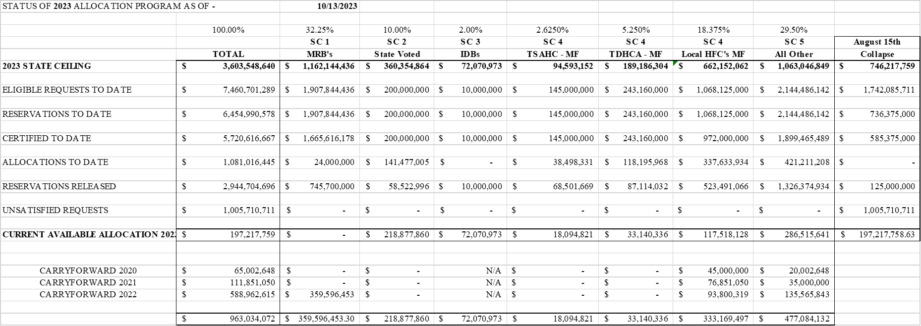
PAB Program Summary as of October 13, 2023

Slide 11
Disclaimer
This communication is intended for issuers for educational and informational purposes only and does not constitute legal or investment advice, nor is it an offer or a solicitation of an offer to buy or sell any investment or other specific product or service. Financial transactions may be dependent upon many factors such as, but not limited to, interest rate trends, tax rates, supply, change in laws, rules and regulations, as well as changes in credit quality and rating agency considerations. The effect of such changes in such assumptions may be material and could affect the projected results. Any outcome or result HilltopSecurities, or any of its employees, may have achieved on behalf of our clients in previous matters does not necessarily indicate similar results can be obtained in the future for current or potential clients. HilltopSecurities makes no claim the use of this communication will assure a successful outcome. This communication is intended for institutional use only. For additional information, comments or questions, please contact Hilltop Securities Inc.

